Slide 1
ALUMNI INFORMATION
MANAGEMENT
SYSTEM
Project Team 41
Team Members :
1. Dhanashri Arun Durge - 210541281042
2. Neha Prakash Dongare - 210541281046

Slide 2
Abstract
The objective of this application is to allow old and new students of a university or college to communicate with each other only through the admin permission. This allows students to know about each other and their current activities.
Technologies Used : Spring, JSP, Servlet, Hibernate, MySQL

Slide 3
Problem Statement
This project is aimed at developing a Repository and search Engine for alumni of the college, which is of great importance to college. The Alumni Information Management System is a web based application that can be accessed throughout the globe. The system is an online application that can be accessed by the organization and outside users as well with proper login provided, which will give better service to the users.

Slide 4
Scope for Future Enhancement :
As the technology emerges, it is possible to upgrade the system and can be adaptable to desired environment.
Because it is based on object-oriented design, any further changes can be easily adaptable.
Based on the future security issues, security can be improved using emerging technologies.
Attendance module can be added
Sub admin module can be added
Students also can see the campus interview details.

Slide 5
Existing System :
The Existing system is a computerized system but which is maintained at individual databases i.e in excels sheets, it’s a time delay process. And maintaining all the records in Excel sheets is difficult. If they want any record they have to search all the records. It doesn’t provide multiple user accessibility and also doesn’t have different user privileges. So the system is not accessible for all the employees of the organization.

Slide 6
Proposed System :
The Proposed system is a computerized system but which is maintained at Centralized databases i.e. in automated forms it’s a very fast process. And maintaining all the records in online systems database which makes it very easy to access and retrieve data from the database. If they want any record they can easily search all the records. It provides multiple user accessibility and also has different user privileges. So the system is accessible for all the employees of the organization.

Slide 7
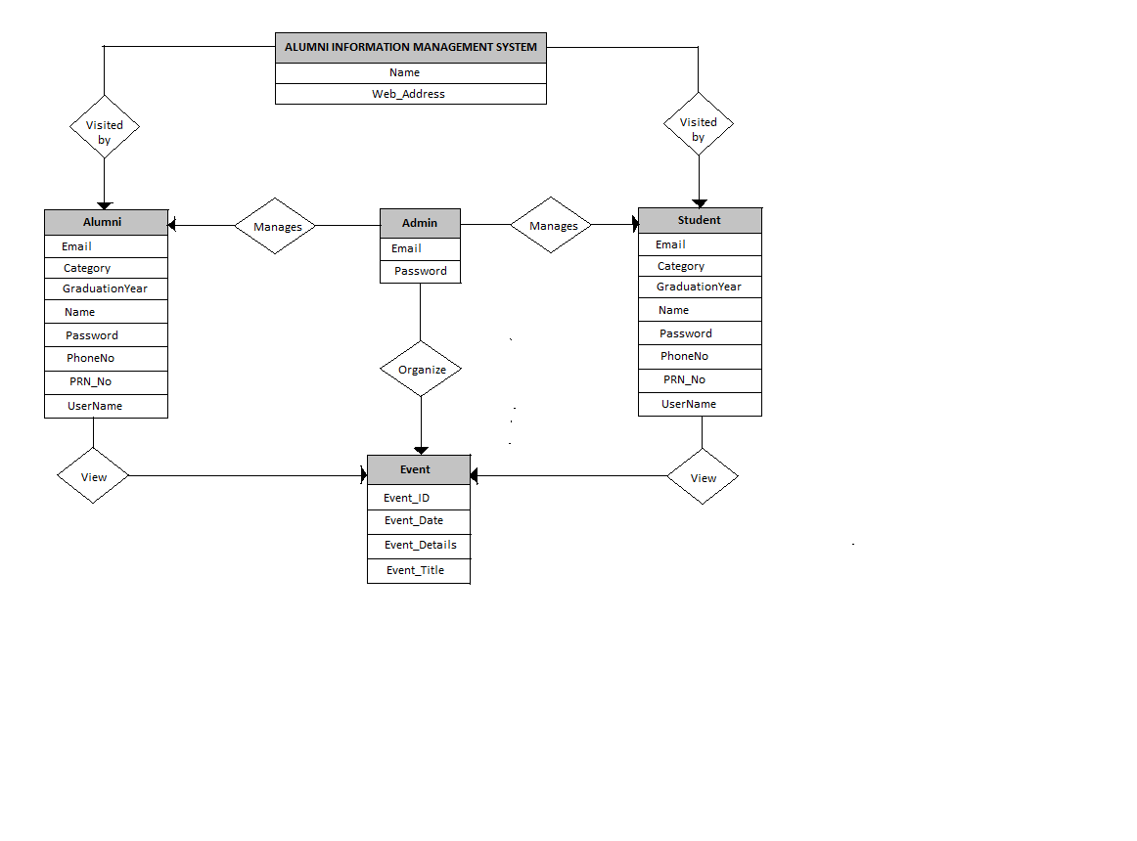
ER Diagram :

Slide 8
Modules :
The System is proposed to have the following modules:
1. Admin:
Administrative Rights, Event update.
2. Alumni:
Restricted access, See events.
3. Student:
Restricted access, See Events.

Slide 9

Welcome Page :

Slide 10
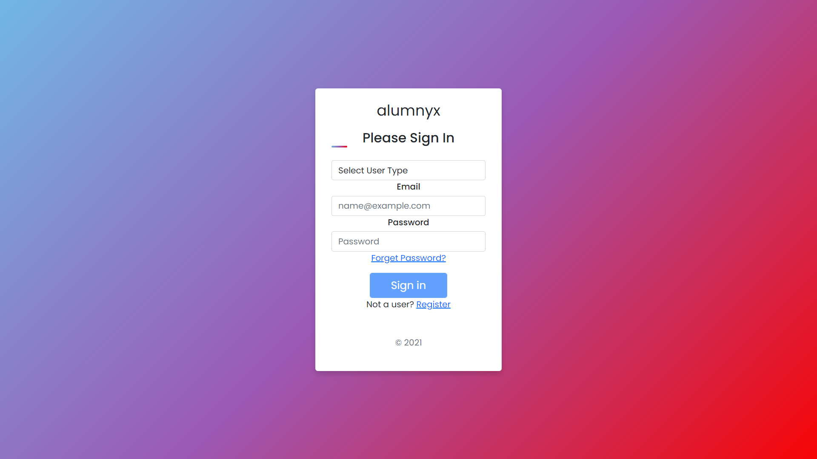
Sign In Page :

Slide 11
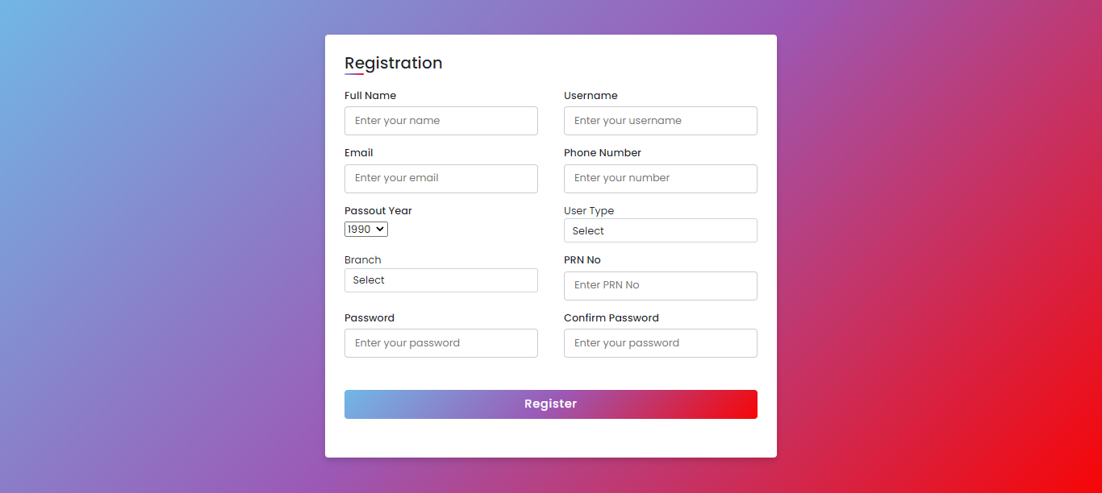
Registration Page :

Slide 12
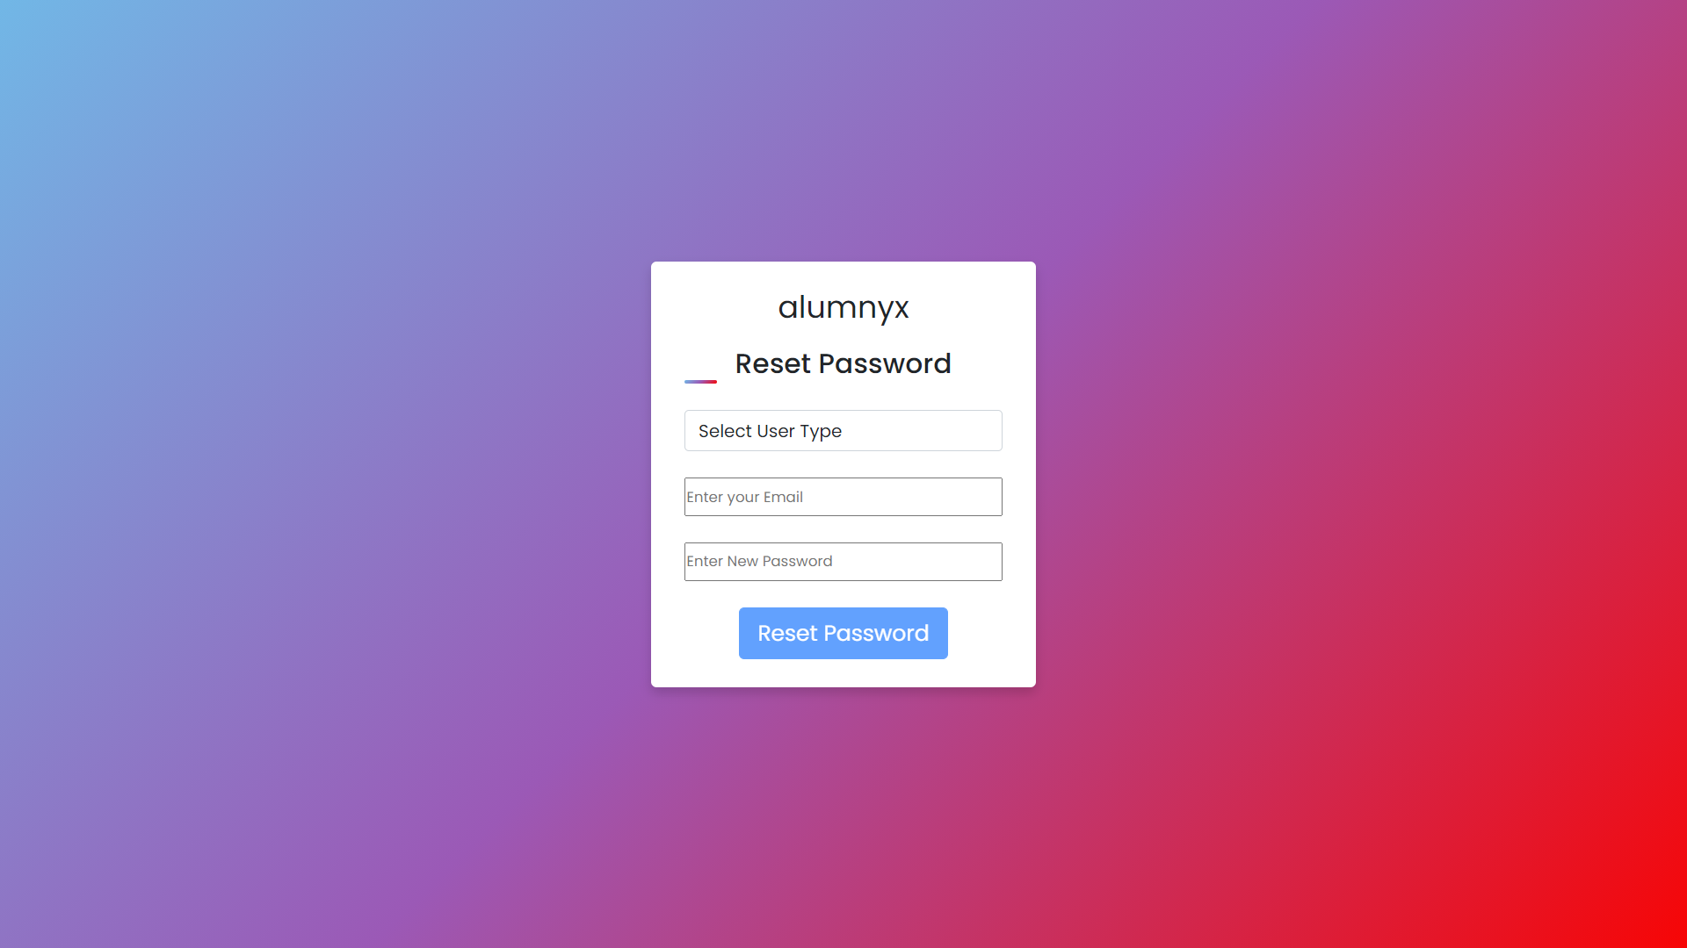
Forget Password Page :

Slide 13
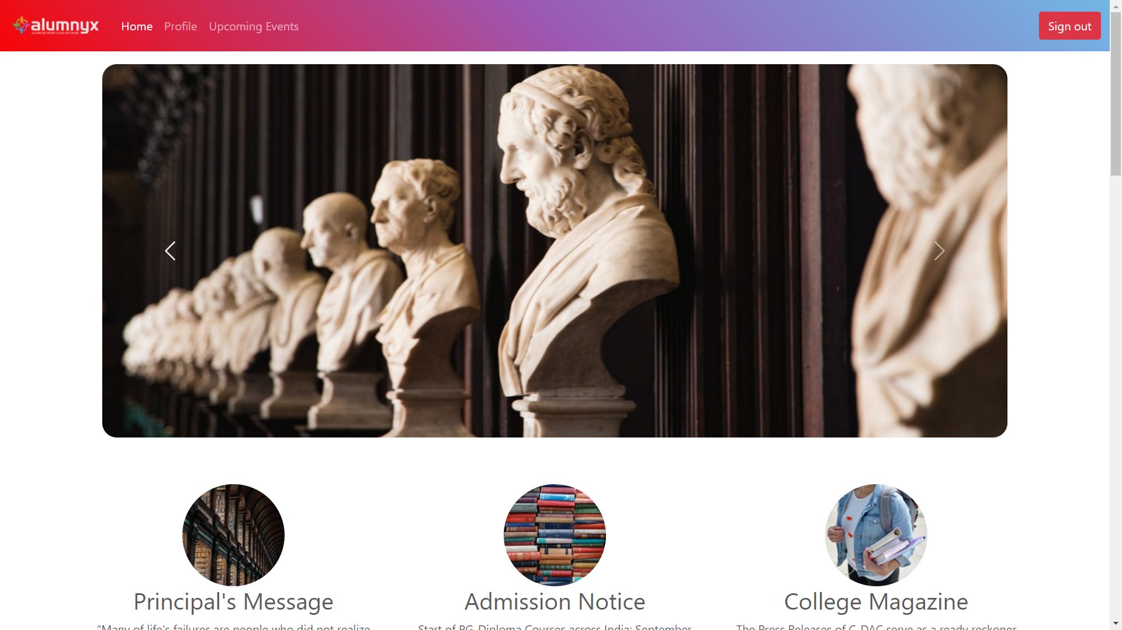
User Home Page :

Slide 14
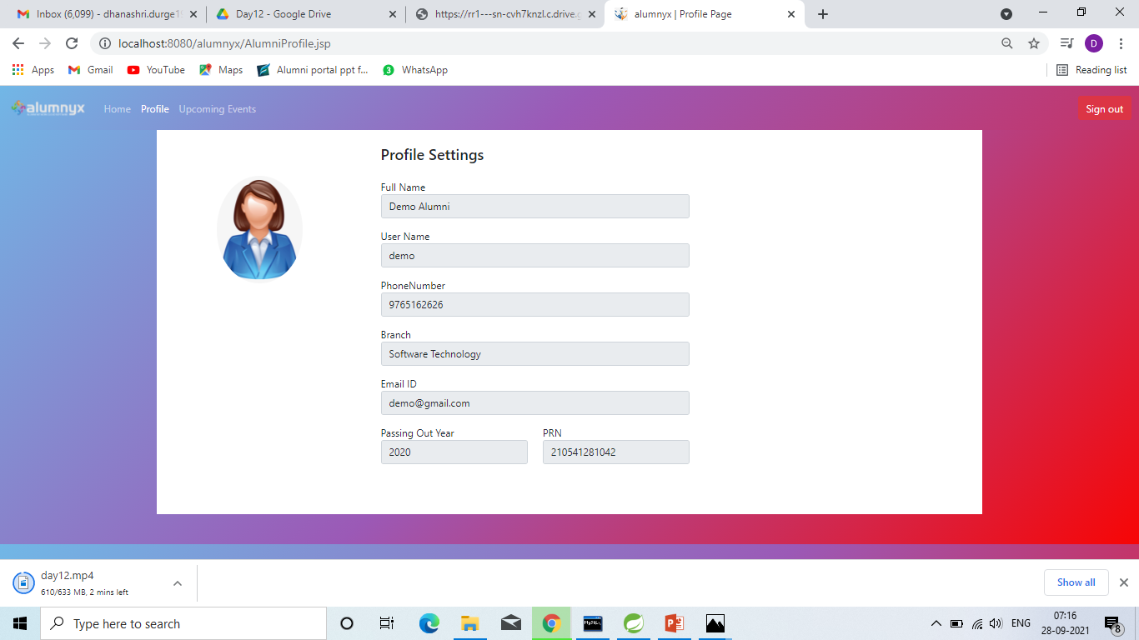
Alumni Profile Page :

Slide 15
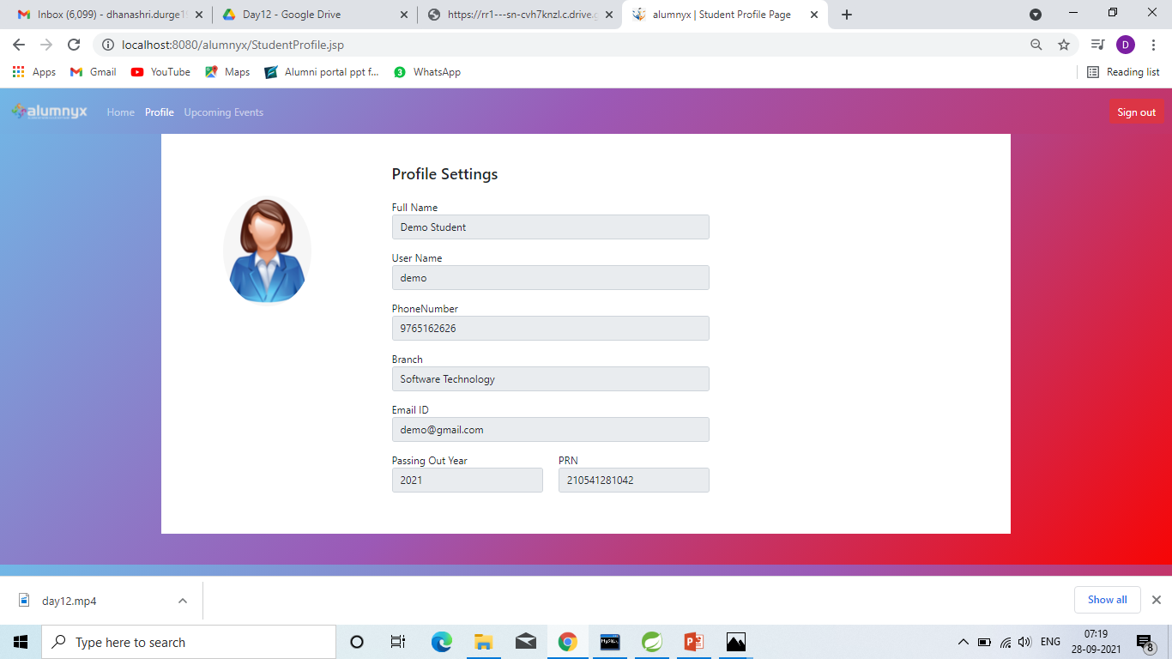
Student Profile Page :

Slide 16
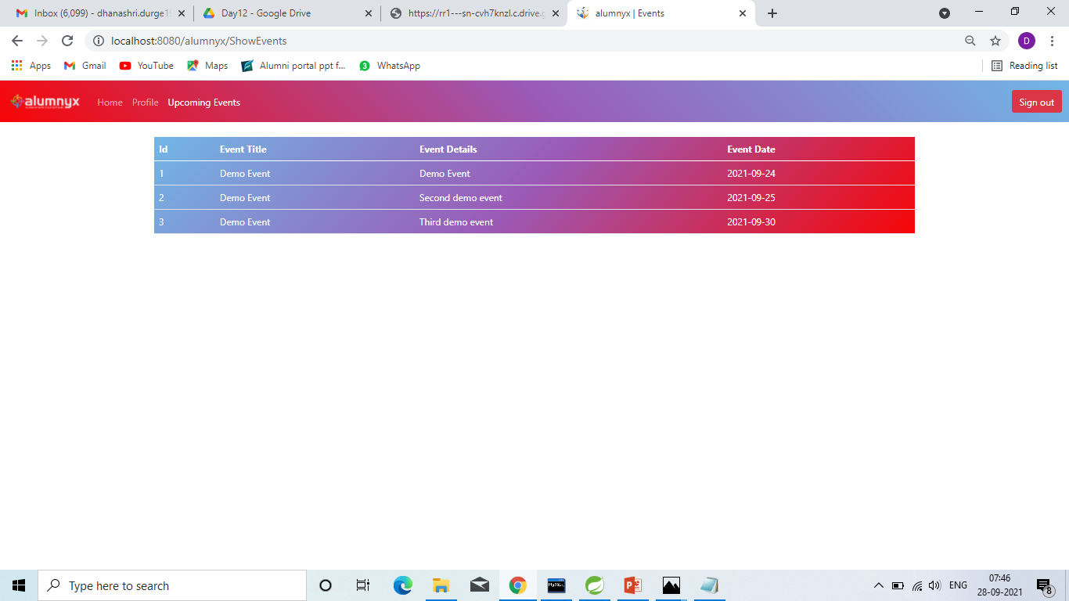
Show Events Page :

Slide 17
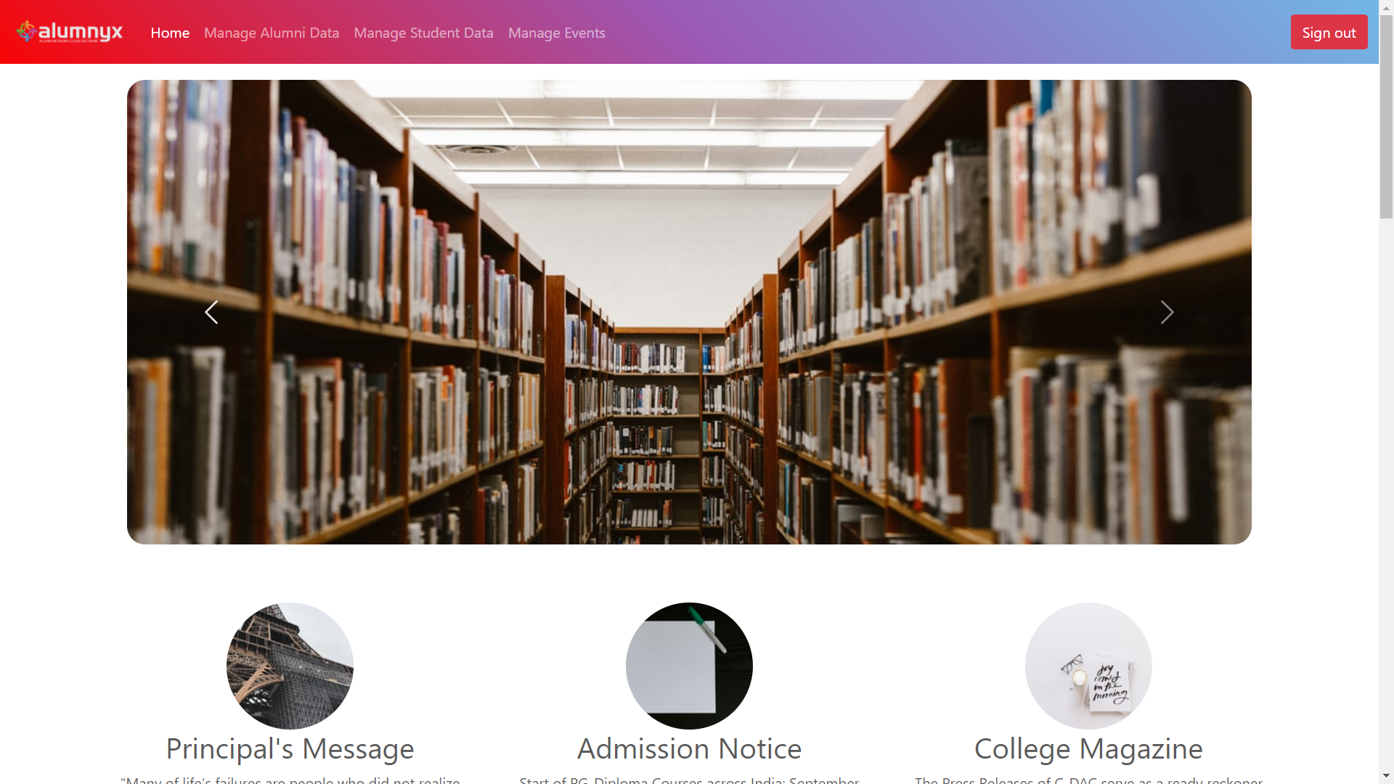
Admin Home Page :

Slide 18
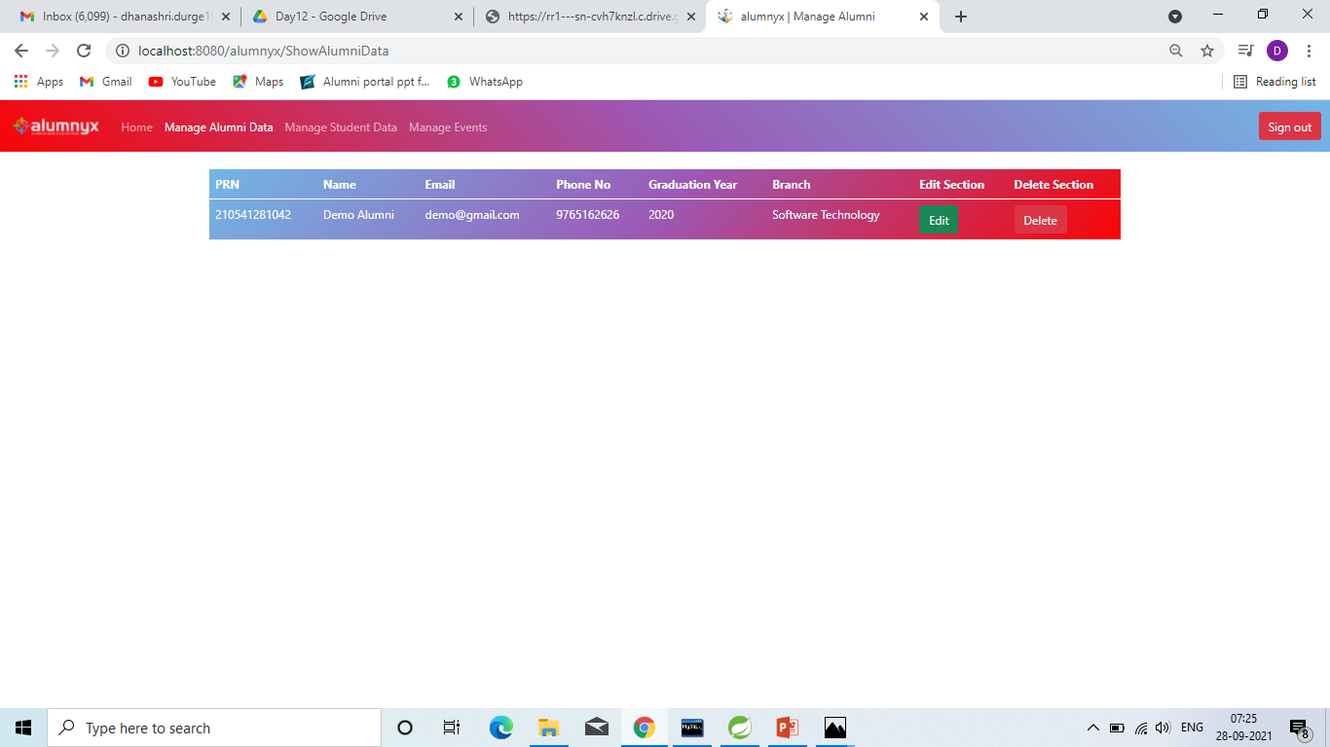
Manage Alumni Data Page :

Slide 19
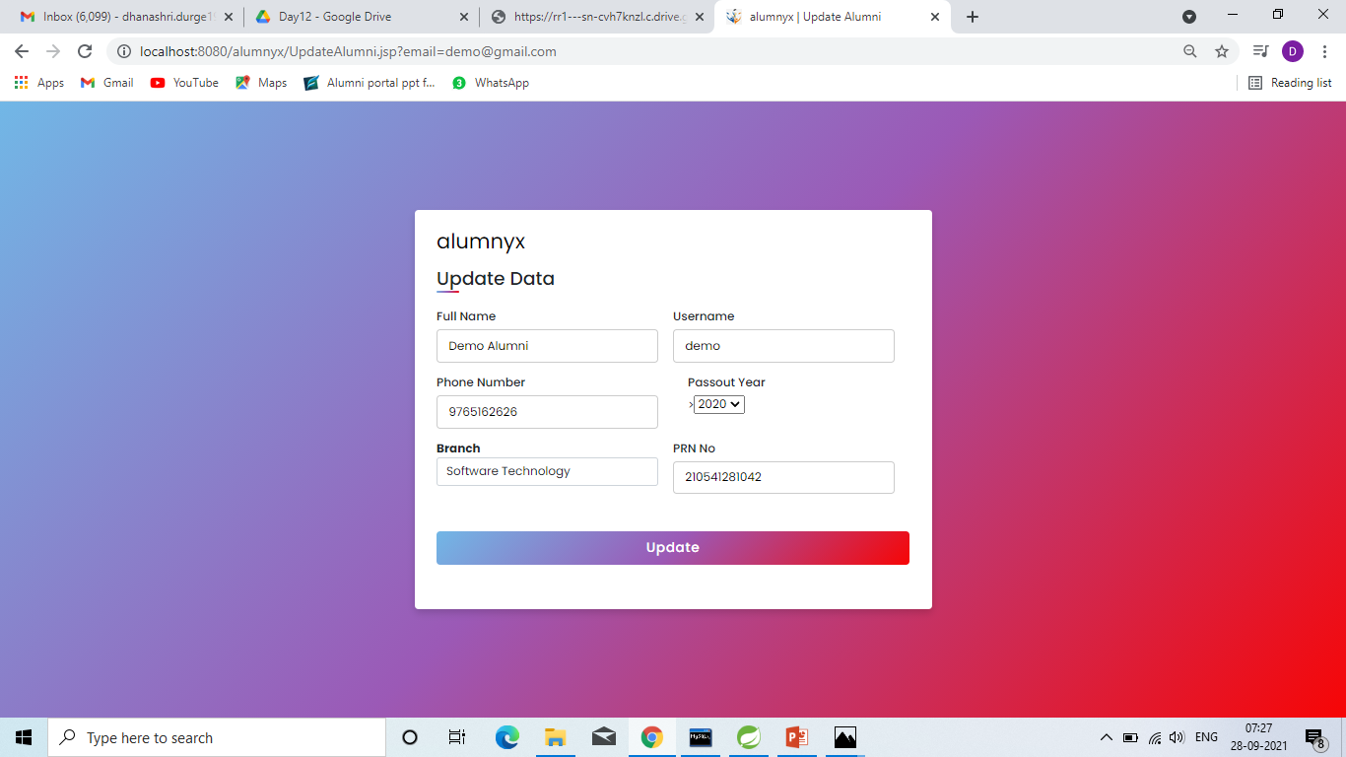
Update Alumni Data Page :

Slide 20
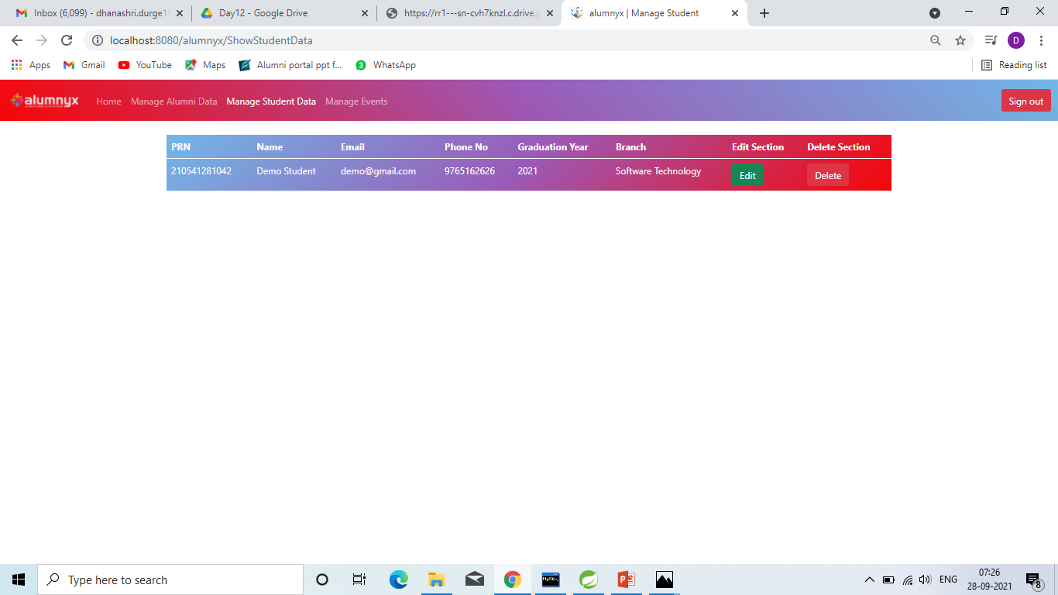
Manage Student Data Page :

Slide 21

Update Student Data Page :

Slide 22
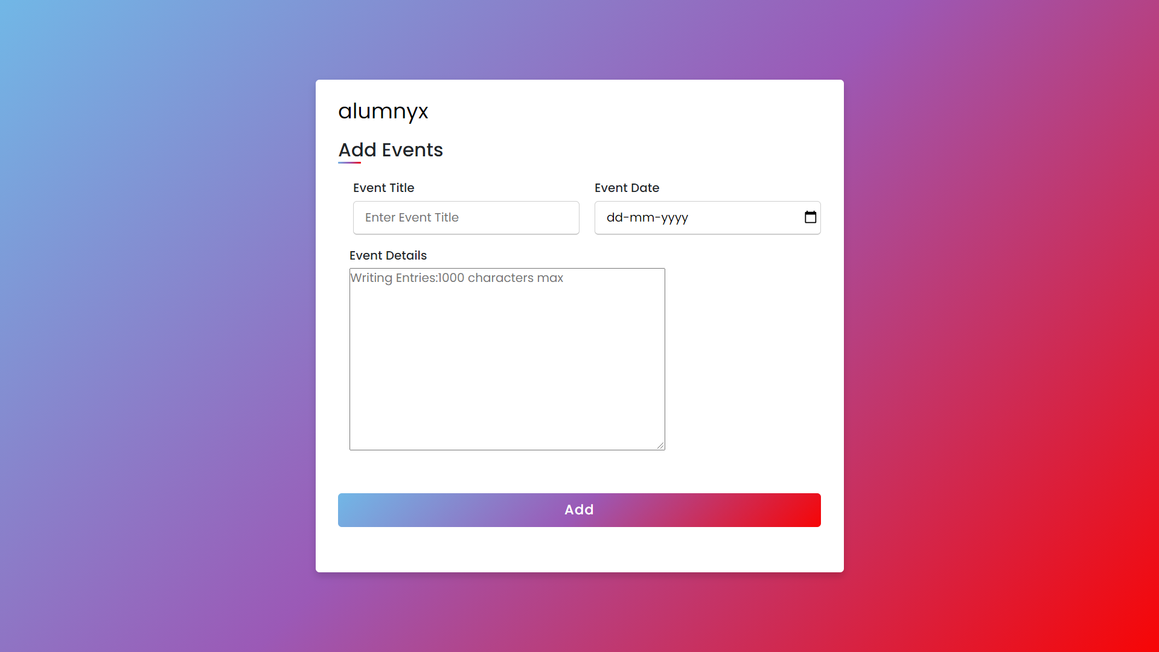
Add Events Page :

Slide 23
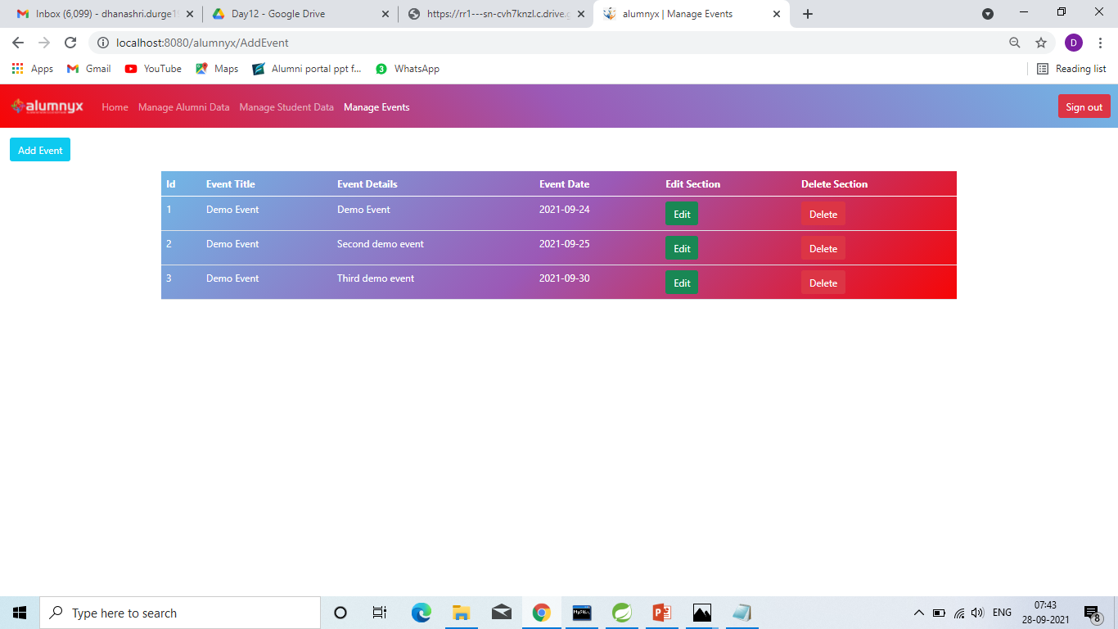
Manage Event Page :

Slide 24
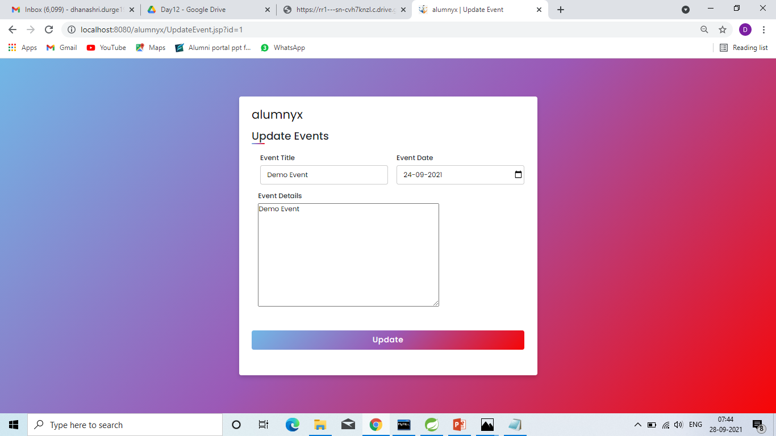
Update Event Page :

Slide 25
Conclusion :
So the Alumni Information Database is mainly used to share the views between the users of the application which is very useful to upgrade the knowledge of everyone. The application is also serve as a useful site to know what is going on in our in our college and can also know about the various opportunities of the outer world.

Slide 26
References :
https://www.javatpoint.com/java-tutorial
https://www.geeksforgeeks.org
https://www.tutorialspoint.com/index.html
https://www.iiscalumni.com

